Slide 1


Session 4: BSTs, Maps & Sets.

Slide 2

Agenda
Quick Recap
BSTs
Practice Problem
Maps
Sets.
Practice Problem Vol.2

Slide 3
Powerful resources
GeeksforGeeks Data structures section: https://www.geeksforgeeks.org/data-structures/?ref=shm
Visualization tool for Data structures: https://www.cs.usfca.edu/~galles/visualization/Algorithms.html
CS50 Data Structures: https://www.youtube.com/watch?v=2T-A_GFuoTo&t=80s
Time Complexity Cheat Sheet: https://www.bigocheatsheet.com/

Slide 4
Recall from the last time.
Non Linear
V
Linear
Data Structures

Slide 5
Binary Search

Slide 6
Binary Search
int binarySearch(int arr[], int x)
{
int l = 0, r = arr.length - 1;
while (l <= r) {
int m = (l + r) / 2;
if (arr[m] == x)
return m;
// If x greater, ignore left half
if (arr[m] < x)
l = m + 1;
// If x is smaller, ignore right half
else
r = m - 1;
}

Slide 7

Binary Search……
Tree?

Slide 8
What is a “Tree” in Computer Science?
In computer science, a tree is a widely used abstract data type that simulates a hierarchical tree structure, with a root value and subtrees of children with a parent node, represented as a set of linked nodes.

Slide 9
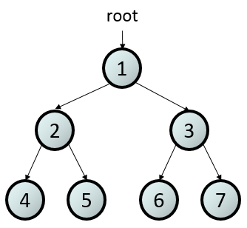
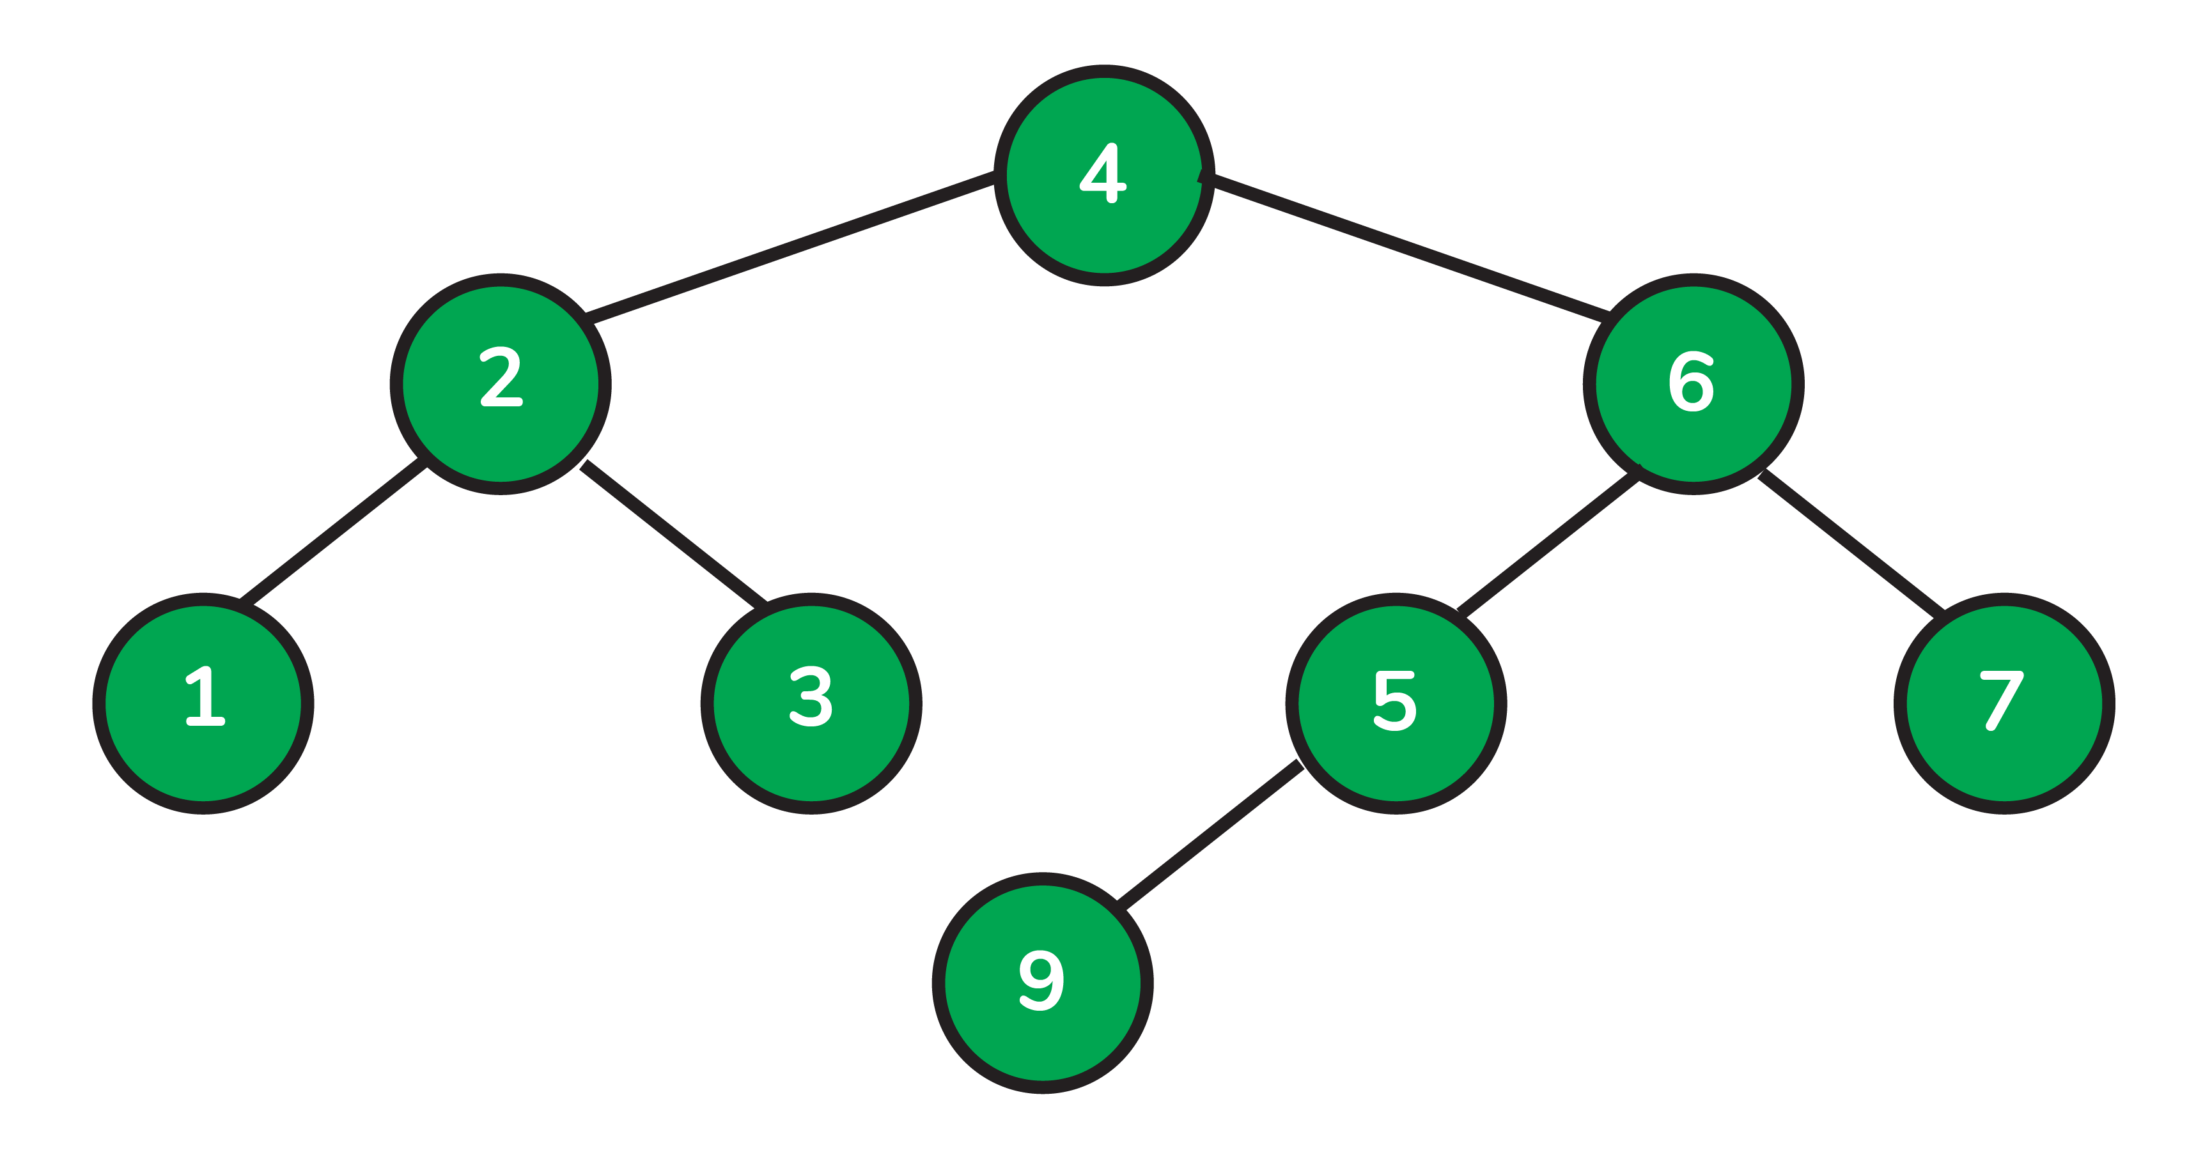
Trees

Slide 10
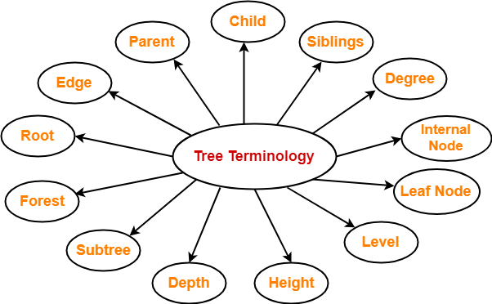
Trees Terminology
More: https://www.gatevidyalay.com/tree-data-structure-tree-terminology/

Slide 11
Balanced Tree V Un-Balanced Tree
A tree is perfectly height-balanced if the left and right subtrees of any node are the same height.

Slide 12
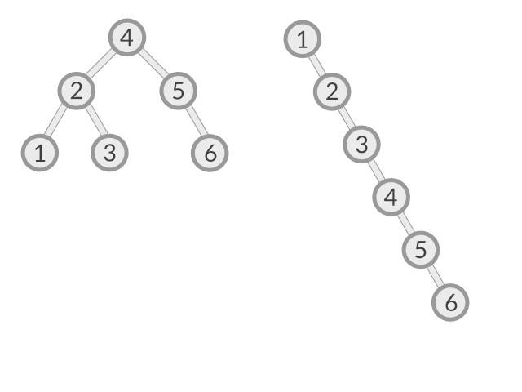
Balanced Tree V Un-Balanced Tree

Slide 13
Let’s discuss Time Complexity
Insertion – search and deletion ?
Arrays ->
Arrays (Sorted) ->
O(N)
Search in O(LogN) but to sort is O(N Log N), but to insert we also have to shift
To search in a linked List?
O(N)

Slide 14
BST
Binary Search Tree (BST), also called an ordered or sorted binary tree, is a rooted binary tree data structure whose internal nodes each store a key greater than all the keys in the node’s left subtree and less than those in its right subtree.
With only 2 children per parent.
The left and right subtree each must also be a binary search tree.
No duplicate values are allowed.

Slide 15
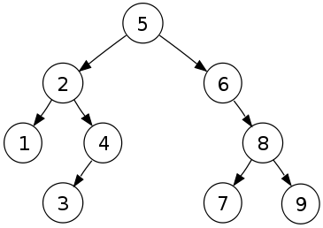
Examples

Slide 16
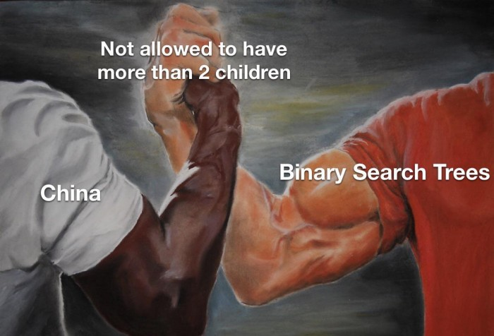

Slide 17
How does it work?
How to write that in code?
class BSTNode
{
}
int data;
BSTNode *left, *right;
public:
// Default constructor.
BSTNode();

Slide 18

Adding elements to a BST
Instructions:
insert(7)
insert(20)
insert(5)
insert(15)
insert(10)
insert(4)
insert(4)
insert(33)
insert(2)
insert(25)
insert(6)

Slide 19

Adding elements to a BST
Instructions:
7
insert(7)
insert(20)
insert(5)
insert(15)
insert(10)
insert(4)
insert(4)
insert(33)
insert(2)
insert(25)
insert(6)

Slide 20

Adding elements to a BST
Instructions:
7
insert(7)
insert(20)
insert(5)
insert(15)
insert(10)
insert(4)
insert(4)
insert(33)
insert(2)
insert(25)
insert(6)

Slide 21
Adding elements to a BST
Instructions:
7
insert(7)
insert(20)
insert(5)
insert(15)
insert(10)
insert(4)
insert(4)
insert(33)
insert(2)
insert(25)
insert(6)
20

Slide 22
Adding elements to a BST
Instructions:
7
insert(7)
insert(20)
insert(5)
insert(15)
insert(10)
insert(4)
insert(4)
insert(33)
insert(2)
insert(25)
insert(6)
20

Slide 23
Adding elements to a BST
Instructions:
7
insert(7)
insert(20)
insert(5)
insert(15)
insert(10)
insert(4)
insert(4)
insert(33)
insert(2)
insert(25)
insert(6)
20

Slide 24
Adding elements to a BST
Instructions:
7
insert(7)
insert(20)
insert(5)
insert(15)
insert(10)
insert(4)
insert(4)
insert(33)
insert(2)
insert(25)
insert(6)
5
20

Slide 25
Adding elements to a BST
Instructions:
7
insert(7)
insert(20)
insert(5)
insert(15)
insert(10)
insert(4)
insert(4)
insert(33)
insert(2)
insert(25)
insert(6)
5
20

Slide 26
Adding elements to a BST
Instructions:
7
insert(7)
insert(20)
insert(5)
insert(15)
insert(10)
insert(4)
insert(4)
insert(33)
insert(2)
insert(25)
insert(6)
5
20

Slide 27
Adding elements to a BST
Instructions:
7
insert(7)
insert(20)
insert(5)
insert(15)
insert(10)
insert(4)
insert(4)
insert(33)
insert(2)
insert(25)
insert(6)
5
20

Slide 28
Adding elements to a BST
Instructions:
7
insert(7)
insert(20)
insert(5)
insert(15)
insert(10)
insert(4)
insert(4)
insert(33)
insert(2)
insert(25)
insert(6)
5
20
15

Slide 29
Adding elements to a BST
Instructions:
7
insert(7)
insert(20)
insert(5)
insert(15)
insert(10)
insert(4)
insert(4)
insert(33)
insert(2)
insert(25)
insert(6)
5
20
15

Slide 30
Adding elements to a BST
Instructions:
7
insert(7)
insert(20)
insert(5)
insert(15)
insert(10)
insert(4)
insert(4)
insert(33)
insert(2)
insert(25)
insert(6)
5
20
15

Slide 31
Adding elements to a BST
Instructions:
7
insert(7)
insert(20)
insert(5)
insert(15)
insert(10)
insert(4)
insert(4)
insert(33)
insert(2)
insert(25)
insert(6)
5
20
15

Slide 32
Adding elements to a BST
Instructions:
7
insert(7)
insert(20)
insert(5)
insert(15)
insert(10)
insert(4)
insert(4)
insert(33)
insert(2)
insert(25)
insert(6)
5
20
15

Slide 33
Adding elements to a BST
Instructions:
7
insert(7)
insert(20)
insert(5)
insert(15)
insert(10)
insert(4)
insert(4)
insert(33)
insert(2)
insert(25)
insert(6)
5
20
15
10

Slide 34
Adding elements to a BST
Instructions:
7
insert(7)
insert(20)
insert(5)
insert(15)
insert(10)
insert(4)
insert(4)
insert(33)
insert(2)
insert(25)
insert(6)
5
20
15
10

Slide 35
Adding elements to a BST
Instructions:
7
insert(7)
insert(20)
insert(5)
insert(15)
insert(10)
insert(4)
insert(4)
insert(33)
insert(2)
insert(25)
insert(6)
5
20
15
10

Slide 36
Adding elements to a BST
Instructions:
7
insert(7)
insert(20)
insert(5)
insert(15)
insert(10)
insert(4)
insert(4)
insert(33)
insert(2)
insert(25)
insert(6)
5
20
15
10

Slide 37
Adding elements to a BST
Instructions:
7
insert(7)
insert(20)
insert(5)
insert(15)
insert(10)
insert(4)
insert(4)
insert(33)
insert(2)
insert(25)
insert(6)
5
20
4
15
10

Slide 38
Adding elements to a BST
Instructions:
7
insert(7)
insert(20)
insert(5)
insert(15)
insert(10)
insert(4)
insert(4)
insert(33)
insert(2)
insert(25)
insert(6)
5
20
4
15
10

Slide 39
Adding elements to a BST
Instructions:
7
insert(7)
insert(20)
insert(5)
insert(15)
insert(10)
insert(4)
insert(4)
insert(33)
insert(2)
insert(25)
insert(6)
5
20
4
15
10

Slide 40
Adding elements to a BST
Instructions:
7
insert(7)
insert(20)
insert(5)
insert(15)
insert(10)
insert(4)
insert(4)
insert(33)
insert(2)
insert(25)
insert(6)
5
20
4
15
10

Slide 41
Adding elements to a BST
Instructions:
7
insert(7)
insert(20)
insert(5)
insert(15)
insert(10)
insert(4)
insert(4)
insert(33)
insert(2)
insert(25)
insert(6)
5
20
4
15
10
We have encountered a value that is already in the tree. do nothing.

Slide 42
Adding elements to a BST
Instructions:
7
insert(7)
insert(20)
insert(5)
insert(15)
insert(10)
insert(4)
insert(4)
insert(33)
insert(2)
insert(25)
insert(6)
5
20
4
15
10

Slide 43
Adding elements to a BST
Instructions:
7
insert(7)
insert(20)
insert(5)
insert(15)
insert(10)
insert(4)
insert(4)
insert(33)
insert(2)
insert(25)
insert(6)
5
20
4
15
10

Slide 44
Adding elements to a BST
Instructions:
7
insert(7)
insert(20)
insert(5)
insert(15)
insert(10)
insert(4)
insert(4)
insert(33)
insert(2)
insert(25)
insert(6)
5
20
4
15
10

Slide 45
Adding elements to a BST
Instructions:
7
insert(7)
insert(20)
insert(5)
insert(15)
insert(10)
insert(4)
insert(4)
insert(33)
insert(2)
insert(25)
insert(6)
5
20
4
15
33
10

Slide 46
Adding elements to a BST
Instructions:
7
insert(7)
insert(20)
insert(5)
insert(15)
insert(10)
insert(4)
insert(4)
insert(33)
insert(2)
insert(25)
insert(6)
5
20
4
15
33
10

Slide 47
Adding elements to a BST
Instructions:
7
insert(7)
insert(20)
insert(5)
insert(15)
insert(10)
insert(4)
insert(4)
insert(33)
insert(2)
insert(25)
insert(6)
5
20
4
15
33
10

Slide 48
Adding elements to a BST
Instructions:
7
insert(7)
insert(20)
insert(5)
insert(15)
insert(10)
insert(4)
insert(4)
insert(33)
insert(2)
insert(25)
insert(6)
5
20
4
15
33
10

Slide 49
Adding elements to a BST
Instructions:
7
insert(7)
insert(20)
insert(5)
insert(15)
insert(10)
insert(4)
insert(4)
insert(33)
insert(2)
insert(25)
insert(6)
5
20
4
15
33
10

Slide 50
Adding elements to a BST
Instructions:
7
insert(7)
insert(20)
insert(5)
insert(15)
insert(10)
insert(4)
insert(4)
insert(33)
insert(2)
insert(25)
insert(6)
5
20
4
15
33
2
10

Slide 51
Adding elements to a BST
Instructions:
7
insert(7)
insert(20)
insert(5)
insert(15)
insert(10)
insert(4)
insert(4)
insert(33)
insert(2)
insert(25)
insert(6)
5
20
4
15
33
2
10

Slide 52
Adding elements to a BST
Instructions:
7
insert(7)
insert(20)
insert(5)
insert(15)
insert(10)
insert(4)
insert(4)
insert(33)
insert(2)
insert(25)
insert(6)
5
20
4
15
33
2
10

Slide 53
Adding elements to a BST
Instructions:
7
insert(7)
insert(20)
insert(5)
insert(15)
insert(10)
insert(4)
insert(4)
insert(33)
insert(2)
insert(25)
insert(6)
5
20
4
15
33
2
10

Slide 54
Adding elements to a BST
Instructions:
7
insert(7)
insert(20)
insert(5)
insert(15)
insert(10)
insert(4)
insert(4)
insert(33)
insert(2)
insert(25)
insert(6)
5
20
4
15
33
2
10

Slide 55
Adding elements to a BST
Instructions:
7
insert(7)
insert(20)
insert(5)
insert(15)
insert(10)
insert(4)
insert(4)
insert(33)
insert(2)
insert(25)
insert(6)
5
20
4
15
33
2
10
25

Slide 56
Adding elements to a BST
Instructions:
7
insert(7)
insert(20)
insert(5)
insert(15)
insert(10)
insert(4)
insert(4)
insert(33)
insert(2)
insert(25)
insert(6)
5
20
4
15
33
2
10
25

Slide 57
Adding elements to a BST
Instructions:
7
insert(7)
insert(20)
insert(5)
insert(15)
insert(10)
insert(4)
insert(4)
insert(33)
insert(2)
insert(25)
insert(6)
5
20
4
15
33
2
10
25

Slide 58
Adding elements to a BST
Instructions:
7
insert(7)
insert(20)
insert(5)
insert(15)
insert(10)
insert(4)
insert(4)
insert(33)
insert(2)
insert(25)
insert(6)
5
20
4
15
33
2
10
25

Slide 59
Adding elements to a BST
Instructions:
7
insert(7)
insert(20)
insert(5)
insert(15)
insert(10)
insert(4)
insert(4)
insert(33)
insert(2)
insert(25)
insert(6)
5
20
4
6
15
33
2
10
25

Slide 60
Adding elements to a BST
Instructions:
7
insert(7)
insert(20)
insert(5)
insert(15)
insert(10)
insert(4)
insert(4)
insert(33)
insert(2)
insert(25)
insert(6)
5
20
4
6
15
33
2
10
25

Slide 61
Adding elements to a BST
Instructions:
7
insert(7)
insert(20)
insert(5)
insert(15)
insert(10)
insert(4)
insert(4)
insert(33)
insert(2)
insert(25)
insert(6)
5
20
4
6
15
33
2
10
25
On average the insertion time will be logarithmic, but in the worst case this could degrade to linear time.

Slide 62
Adding elements to a BST
Instructions:
1
insert(1)
insert(2)
insert(3)
insert(4)
insert(5)
insert(6)

Slide 63
Adding elements to a BST
Instructions:
1
insert(1)
insert(2)
insert(3)
insert(4)
insert(5)
insert(6)

Slide 64
Adding elements to a BST
Instructions:
1
insert(1)
insert(2)
insert(3)
insert(4)
insert(5)
insert(6)

Slide 65
Adding elements to a BST
Instructions:
1
insert(1)
insert(2)
insert(3)
insert(4)
insert(5)
insert(6)
2

Slide 66
Adding elements to a BST
Instructions:
1
insert(1)
insert(2)
insert(3)
insert(4)
insert(5)
insert(6)
2

Slide 67
Adding elements to a BST
Instructions:
1
insert(1)
insert(2)
insert(3)
insert(4)
insert(5)
insert(6)
2

Slide 68
Adding elements to a BST
Instructions:
1
insert(1)
insert(2)
insert(3)
insert(4)
insert(5)
insert(6)
2

Slide 69
Adding elements to a BST
Instructions:
1
insert(1)
insert(2)
insert(3)
insert(4)
insert(5)
insert(6)
2
3

Slide 70
Adding elements to a BST
Instructions:
1
insert(1)
insert(2)
insert(3)
insert(4)
insert(5)
insert(6)
2
3

Slide 71
Adding elements to a BST
Instructions:
1
insert(1)
insert(2)
insert(3)
insert(4)
insert(5)
insert(6)
2
3

Slide 72
Adding elements to a BST
Instructions:
1
insert(1)
insert(2)
insert(3)
insert(4)
insert(5)
insert(6)
2
3

Slide 73
Adding elements to a BST
Instructions:
1
insert(1)
insert(2)
insert(3)
insert(4)
insert(5)
insert(6)
2
3

Slide 74
Adding elements to a BST
Instructions:
1
insert(1)
insert(2)
insert(3)
insert(4)
insert(5)
insert(6)
2
3
4

Slide 75
Adding elements to a BST
Instructions:
1
insert(1)
insert(2)
insert(3)
insert(4)
insert(5)
insert(6)
2
3
4

Slide 76
Adding elements to a BST
Instructions:
1
insert(1)
insert(2)
insert(3)
insert(4)
insert(5)
insert(6)
2
3
4

Slide 77
Adding elements to a BST
Instructions:
1
insert(1)
insert(2)
insert(3)
insert(4)
insert(5)
insert(6)
2
3
4

Slide 78
Adding elements to a BST
Instructions:
1
insert(1)
insert(2)
insert(3)
insert(4)
insert(5)
insert(6)
2
3
4

Slide 79
Adding elements to a BST
Instructions:
1
insert(1)
insert(2)
insert(3)
insert(4)
insert(5)
insert(6)
2
3
4

Slide 80
Adding elements to a BST
Instructions:
1
insert(1)
insert(2)
insert(3)
insert(4)
insert(5)
insert(6)
2
3
4
5

Slide 81
Adding elements to a BST
Instructions:
1
insert(1)
insert(2)
insert(3)
insert(4)
insert(5)
insert(6)
2
3
4
5

Slide 82
Adding elements to a BST
Instructions:
1
insert(1)
insert(2)
insert(3)
insert(4)
insert(5)
insert(6)
2
3
4
5

Slide 83
Adding elements to a BST
Instructions:
1
insert(1)
insert(2)
insert(3)
insert(4)
insert(5)
insert(6)
2
3
4
5

Slide 84
Adding elements to a BST
Instructions:
1
insert(1)
insert(2)
insert(3)
insert(4)
insert(5)
insert(6)
2
3
4
5

Slide 85
Adding elements to a BST
Instructions:
1
insert(1)
insert(2)
insert(3)
insert(4)
insert(5)
insert(6)
2
3
4
5

Slide 86
Adding elements to a BST
Instructions:
1
insert(1)
insert(2)
insert(3)
insert(4)
insert(5)
insert(6)
2
3
4
5

Slide 87
Adding elements to a BST
Instructions:
1
insert(1)
insert(2)
insert(3)
insert(4)
insert(5)
insert(6)
2
3
4
5
6

Slide 88
Adding elements to a BST
Instructions:
1
insert(1)
insert(2)
insert(3)
insert(4)
insert(5)
insert(6)
2
3
4
5
This type of linear behavior is very bad and is the reason why balanced binary search trees were invented.
6

Slide 89
How insert works in code (Recursion)
BST* BST ::Insert(BST* root, int value)
{
if (!root)
{
// Insert the first node, if root is NULL.
return new BST(value);
}
// Insert data.
if (value > root->data)
{
// Insert right node data, if the 'value'
// to be inserted is greater than 'root' node data.
// Process right nodes.
root->right = Insert(root->right, value);
}
else
{
// Insert left node data, if the 'value'
// to be inserted is greater than 'root' node data.
// Process left nodes.
root->left = Insert(root->left, value);
}
// Return 'root' node, after insertion.
return root;
}

Slide 90
Your turn! Complete the search code!
struct node* search(struct node* root, int value)
{
// Base Cases: root is null or value found at root
if (root == NULL || root->value == value)
return root;
// value is greater than root's value
fill this
// value is smaller than root's value
fill this
}

Slide 91
Solution
struct node* search(struct node* root, int value)
{
// Base Cases: root is null or value found at root
if (root == NULL || root->value == value)
return root;
if (root->value < value)
return search(root->right, value);
else
return search(root->left, value);
}

Slide 92
BST’s conclusion
Let’s watch A small video together

Slide 93
Five Minutes Break

Slide 94
Why?
Binary search trees allow binary search for fast lookup, addition and removal of data items.
Binary Space Partition: Used in almost every 3D video game to determine what objects need to be rendered.
More: https://stackoverflow.com/questions/2130416/what-are-the-applications-of-binary-trees

Slide 95
STL::Sets
Sets are a type of associative containers in which each element has to be unique because the value of the element identifies it. The values are stored in a specific order.

Slide 96
STL::Sets
1 -The set stores the elements in sorted order.
2- All the elements in a set have unique values.
3- Sets follow the Binary search tree implementation.
4- The values in a set are unindexed.

Slide 97
STL::Sets - Functions
insert(X) – inserts X into the set
begin() – Returns an iterator to the first element in the set.
end() – Returns an iterator to the last element (till now).
size() – Returns the number of elements in the set.
max_size() – Returns the maximum number of elements that the set can hold.
empty() – Returns whether the set is empty.
More: https://www.cplusplus.com/reference/set/set/

Slide 98
STL::Multisets
Multisets are a type of associative containers similar to set, with an exception that multiple elements can have same values.

Slide 99
STL::Maps
Maps are associative containers that store elements in a mapped fashion. Each element has a key value and a mapped value. No two mapped values can have same key values.

Slide 100
STL::Maps
begin() – Returns an iterator to the first element in the map
end() – Returns an iterator to the last elemtn
size() – Returns the number of elements in the map
empty() – Returns whether the map is empty
pair insert(keyvalue, mapvalue) – Adds a new element to the map
erase(iterator position) – Removes the element at the position pointed by the iterator
clear() – Removes all the elements from the map

Slide 101
Let’s Practice
Given a list of integers of size N, Remove the duplicates and output it sorted.
Example: N = 8, [1,1,2,3,4,4,9,0]
Output: [1, 2, 3, 4, 9, 0]

Slide 102
Can we do better?
Now we can insert delete and search in Log(N), Can we do better? O(1)??
Find this out next Sunday.
Thank You!

